Slide 1
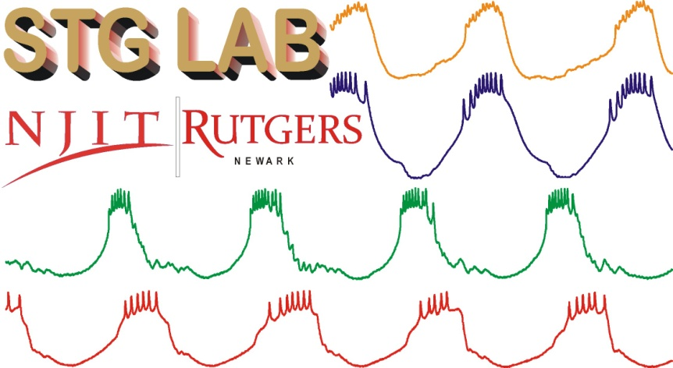
Stochastic Dynamics
&
Small Networks
Farzan Nadim

Slide 2
The “brain” as a machine
There is significant variability in the activity of neurons and networks.
How does the brain produce reliable output (consistent behaviors)?
Does the robustness of functional networks overcome the variability due to noise?
Or is stochasticity a necessary component of how the system works?
  (Yarom & Hounsgaard 2011)
What can we learn from Small Networks?

Slide 3
“Noise” in the nervous system
“The brain is noisy.” (Ermentrout et al, 2008)
“Noise…poses a fundamental problem for information processing and affects all aspects of nervous-system function.” (Faisal et al, 2008)
In the context of the “neural code”…
  For rate code: “variations in inter-spike intervals might be considered unwanted noise.”
  For temporal code: “variability can be an important part of the signal.” (Stein et al, 2005)

Slide 4
Sources of “noise”
Cell noise
  primarily channel noise
Synaptic noise
  variability of individual synapses (channel and biochemical noise)
  combined synaptic input from multiple neurons
Biochemical noise (calcium effects, signal amplification)
Other
  Natural variability of inputs to do other CNS activity

Slide 5
Big Questions
How does a neuronal network perform its function despite all the noise in the inputs?
Do neurons or networks use noise to their benefit?

Slide 6
Definitions
Noise: random fluctuations or disturbance that attenuates signal clarity
Variability:
  Temporal variability in the input signal
  Spatial variability in the input signal
  Temporal variability in the output
  Trial-to-trial variability in the response
  Spike-time variability (ISI distribution)
Not all variability is random. So variability ≠ noise?
  Perhaps the most useful way of defining “noise” is as trial-to-trial variability
Stochastic Facilitation (Ward):
Stochastic Resonance: Increase in signal-to-noise ratio when the input has a finite-amplitude noise
Coherence Resonance: Addition of noise to system makes oscillations more coherent
Stochastic Synchrony: neurons (even if not connected) become more synchronous if they receive correlated noise

Slide 7
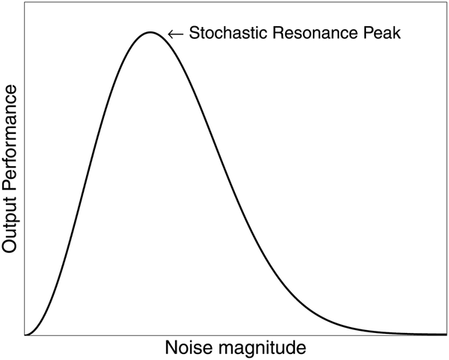
Stochastic Resonance
(McDonnell & Abbott, 2009)
Inputs and outputs of the system should be clearly defined.
System needs to be sub-optimal.
System needs to be nonlinear.
Aperiodic S.R. (Collins Chow Imhoff, 1995)

Slide 8
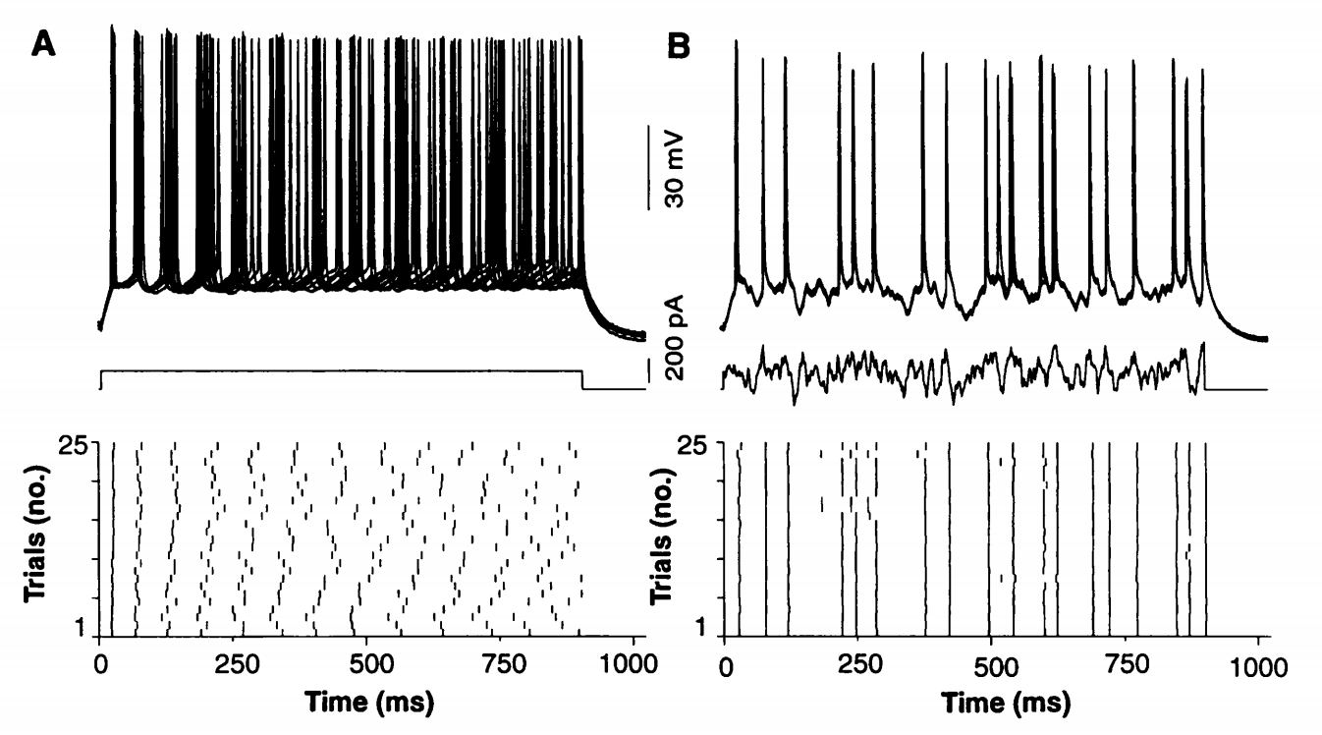
Constant vs. variable inputs
What if the output of importance is not the spike timing?
  Which signal is optimal in spike rate?
  Or intensity of the burst?

Slide 9
Constant vs. noisy inputs
(Mainen & Sejnowski 1995)

Slide 10
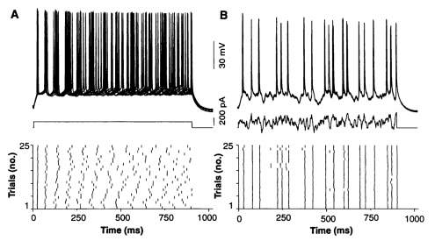
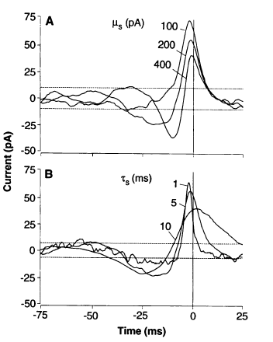
Constant vs. noisy inputs
Noisy inputs cause reliable spiking…
(Ermentrout et al, 2008)
Spike-triggered stimulus averages suggest that consistent temporal coding follows in part from a greater sensitivity of spike generation to transients than to steady-state depolarization.
(Mainen & Sejnowski, 1995)

Slide 11
Constant vs. noisy inputs
variable
^
Low temporal variability
↓
High trial-to-trial variability (noise)
High temporal variability
↓
Low trial-to-trial variability (noise)

Slide 12
Spatial-variability analogue of the Mainen & Sejnowski effect?

Slide 13
Bayesian Hypothesis
The CNS (or at least sensory systems) represents “information” as probability distributions, so the noisiness of neuronal activity is in fact essential to its operation. (Knill & Pouget 2004)

Slide 14
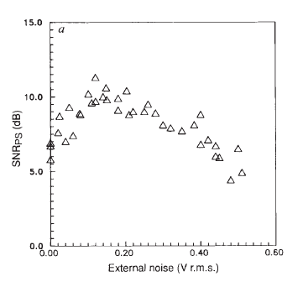
Advantages of small networks
Stochastic Resonance in the nervous system first demonstrated in crayfish mechanoreceptors (Douglass et al, 1993)
SR in cricket cercal sensory system (Levin & Miller, 1996)

Slide 15
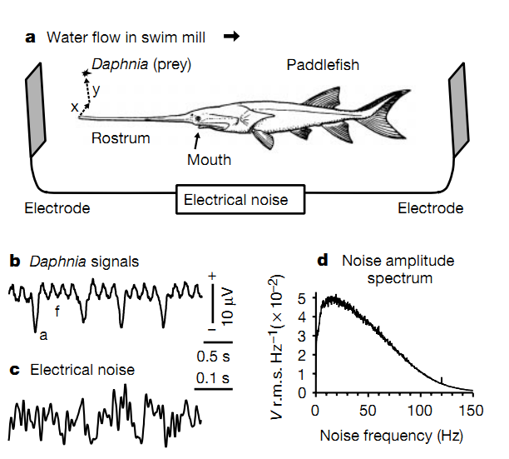
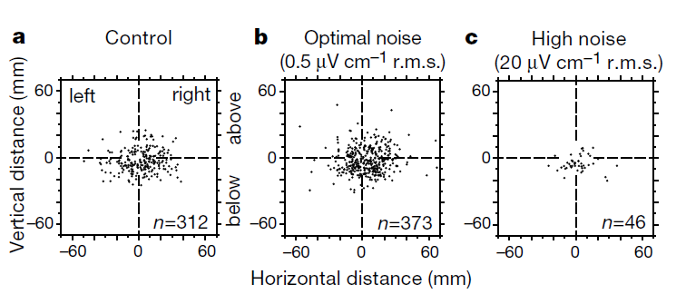
Effects on behavior
Stochastic Resonance in Paddlefish prey detection
(Russell et al, 1999)

Slide 16
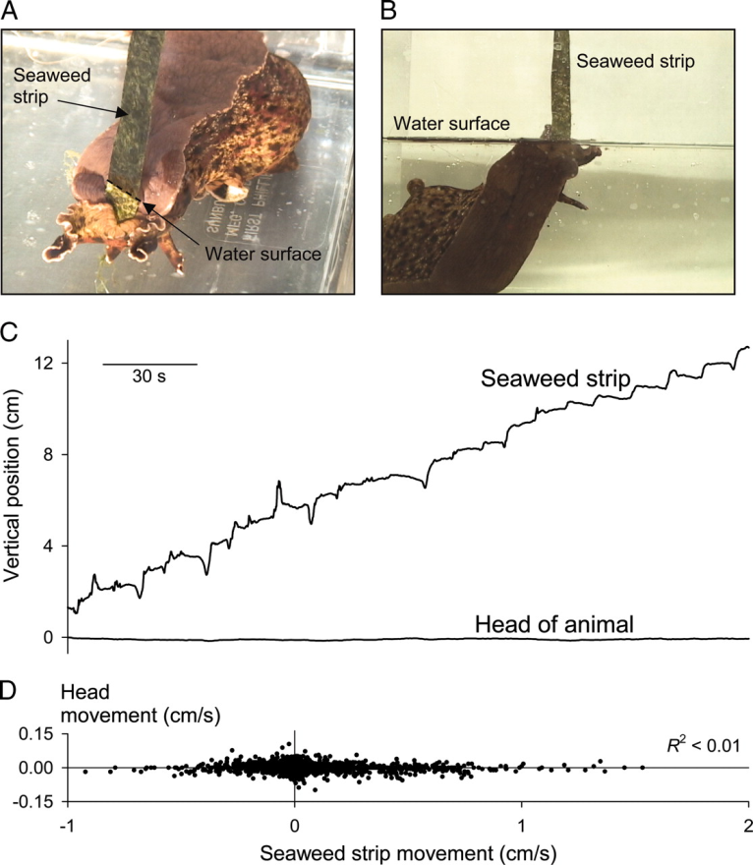
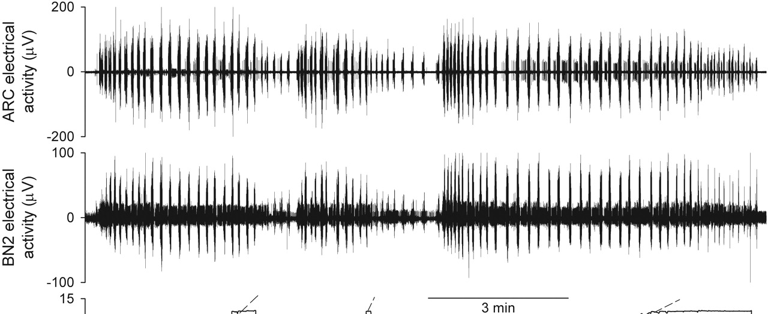
Variability in motor output
Lum et al 2005

Slide 17
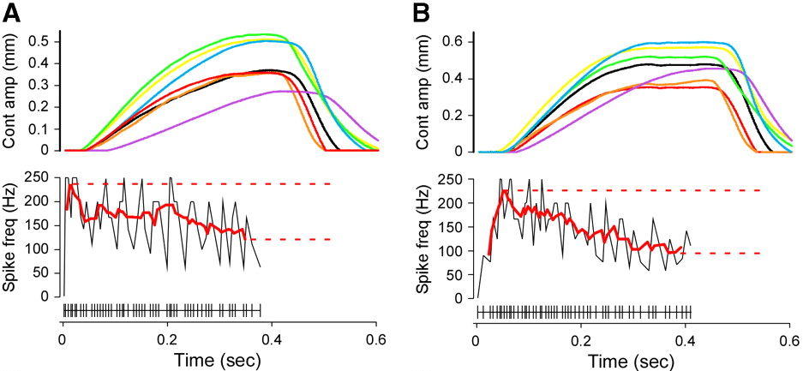
Variability in motor neuron activity
Transformation of neural code is not always obvious.
  Spike number, not frequency, codes extensor amplitude (stick insect).
  Steadily declining input is transformed to constant amplitude output.
  Fine temporal variability of motor neuron output is mostly ignored.
Hooper et al. 2007

Slide 18
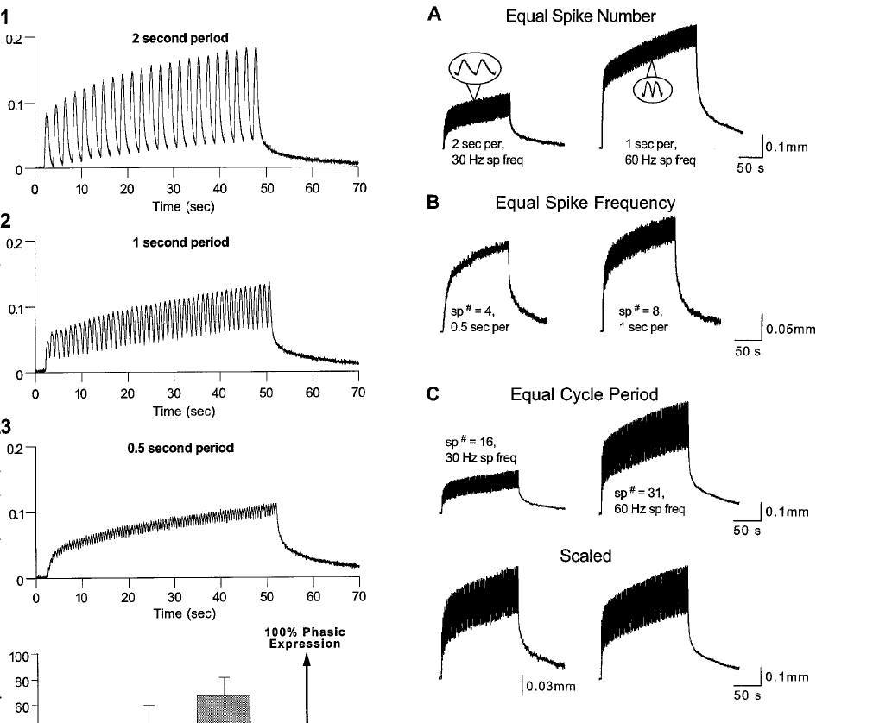
Slow muscles transform spike frequency, spike numbers and burst cycle frequency
Morris & Hooper 1998

Slide 19
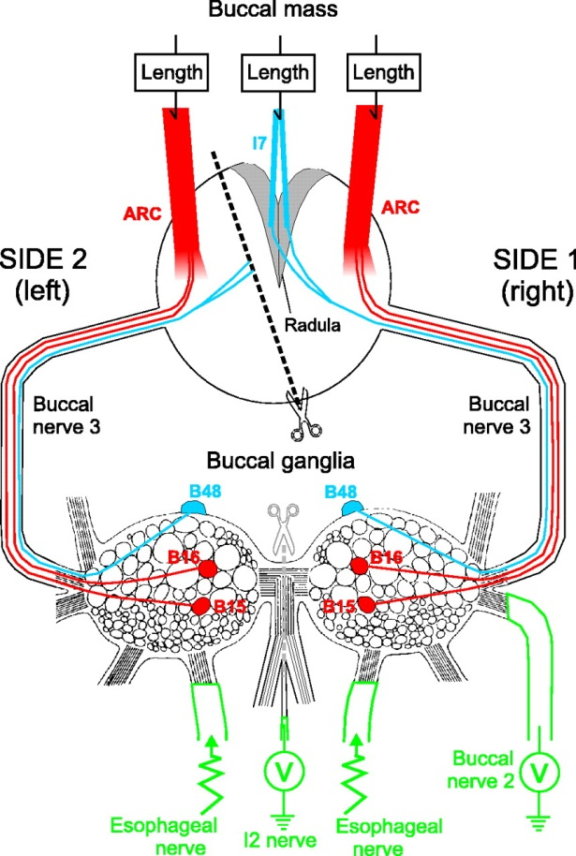
Measuring the neuromuscular transform
Zhurov & Brezina 2006

Slide 20
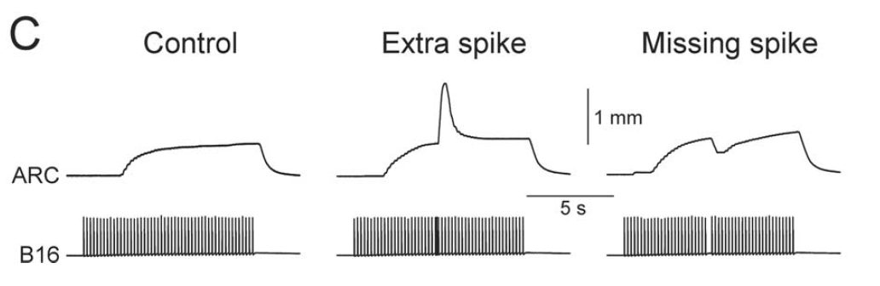
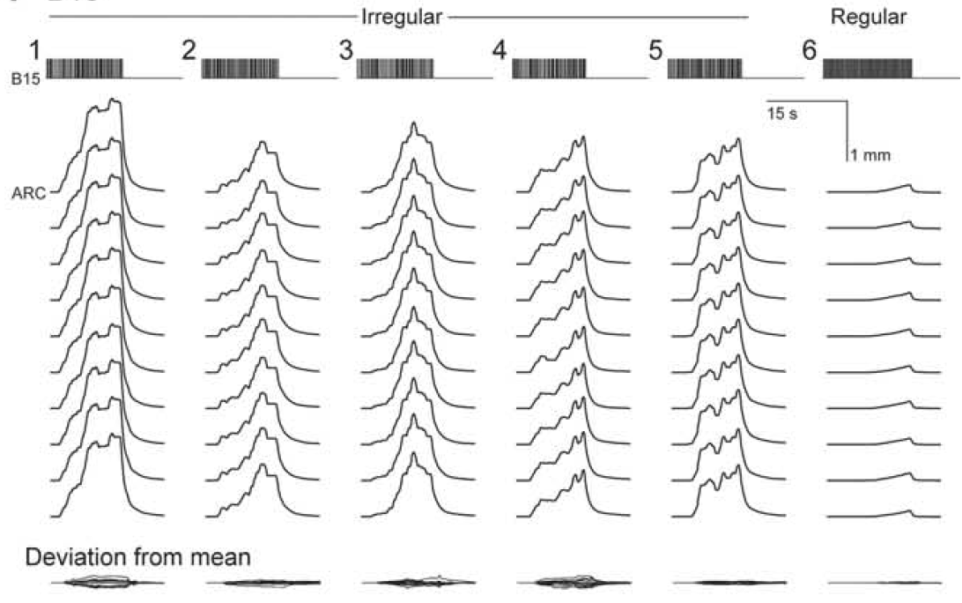
Measuring the neuromuscular transform
Zhurov & Brezina 2006

Slide 21
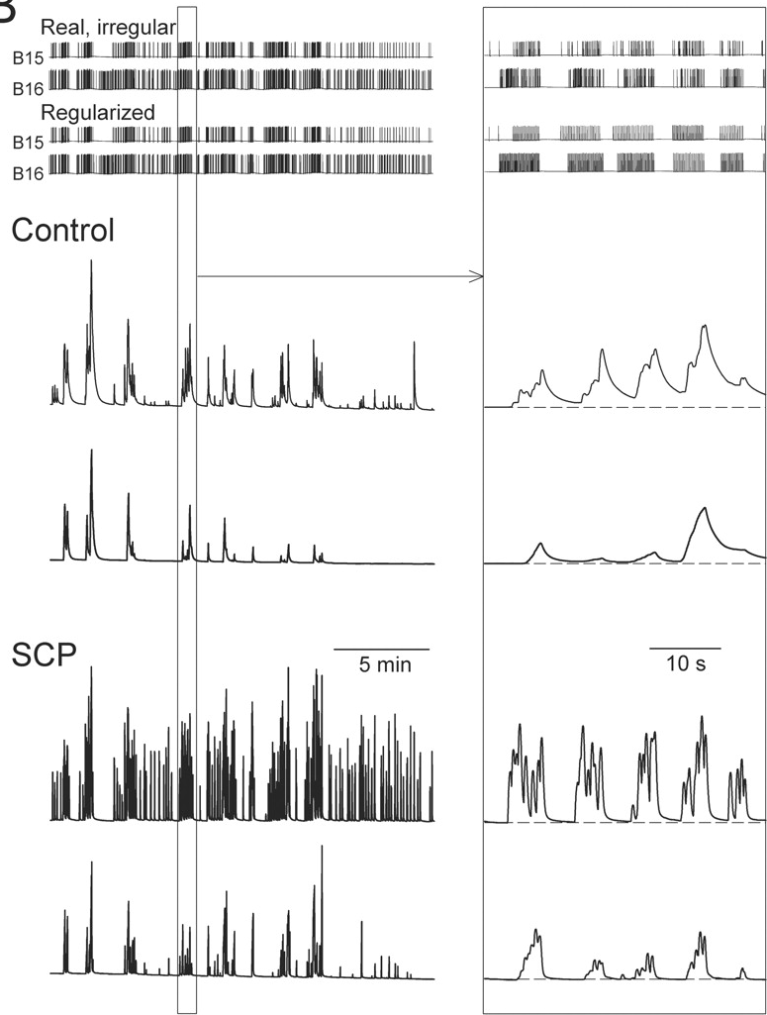
Measuring the neuromuscular transform
Zhurov & Brezina 2006

Slide 22
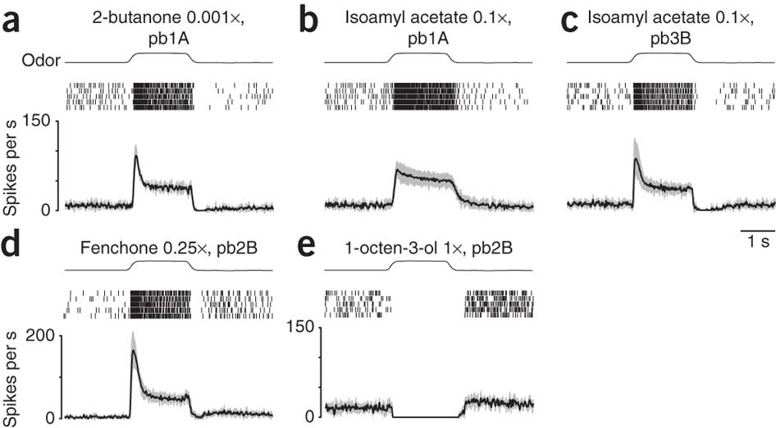
Temporal variability can be subject to filtering in sensory systems
Nagel & Wilson, 2011

Slide 23
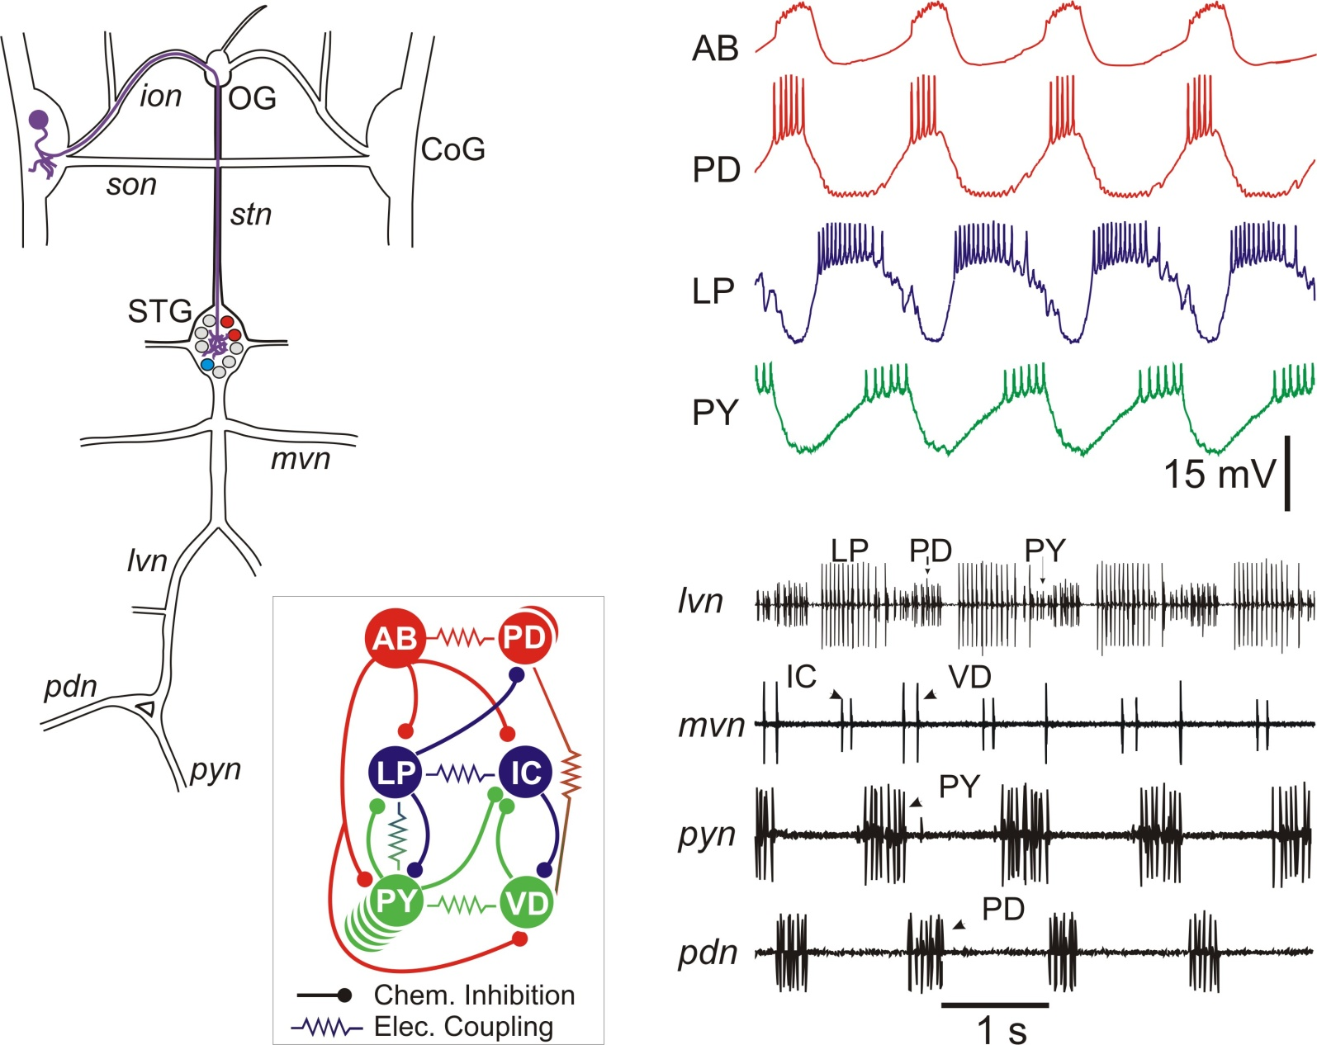
Knowing the circuitry helps

Slide 24
Modulator-induced variability
1 μM Proctolin
10 μM Octopamine

Slide 25
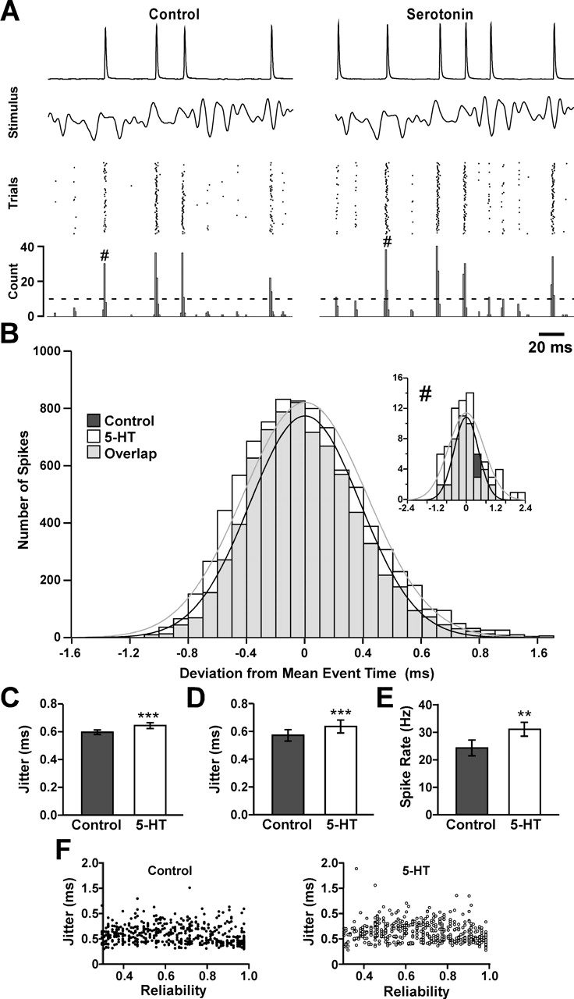
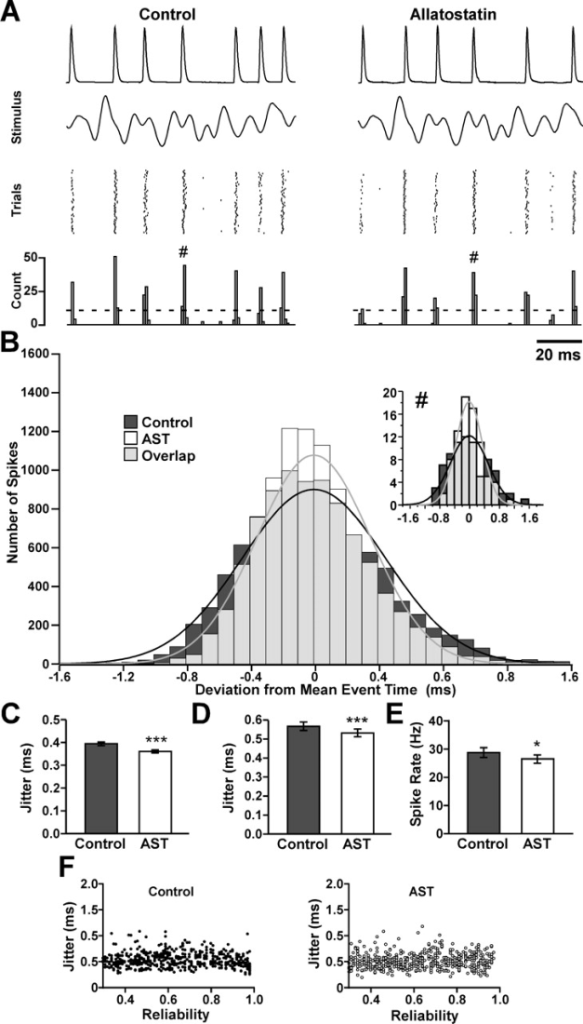
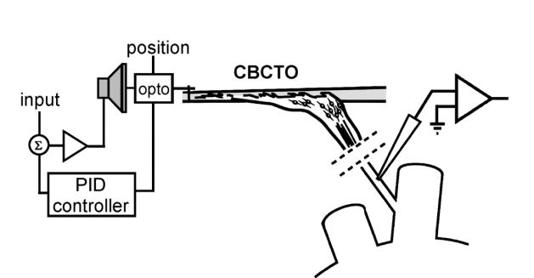
Exploring neuromodulatory Effects in sensory systems
Opposing effects of AST and DA on the coxobasal chordotonal organ response in Carcinus maenas
Billimoria et al 2006

Slide 26
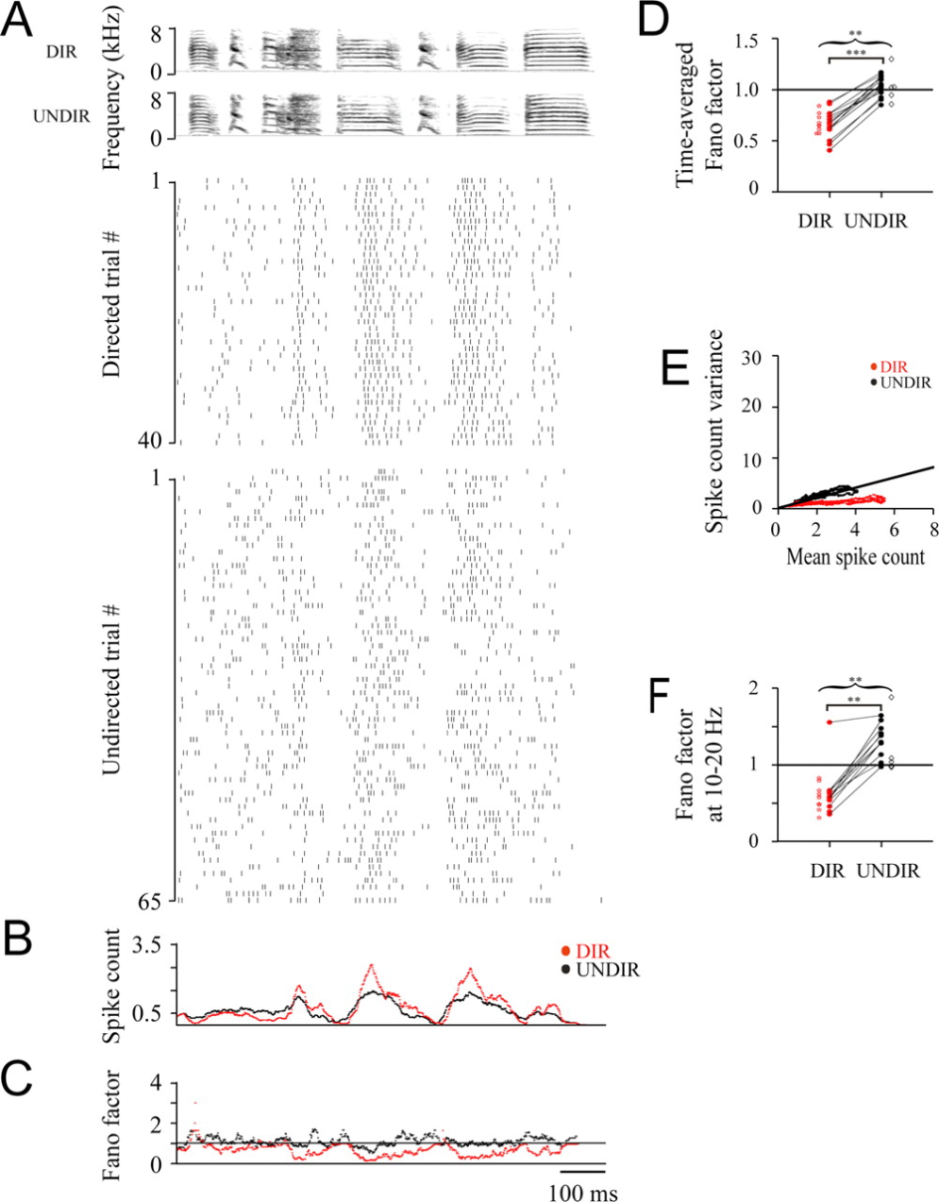
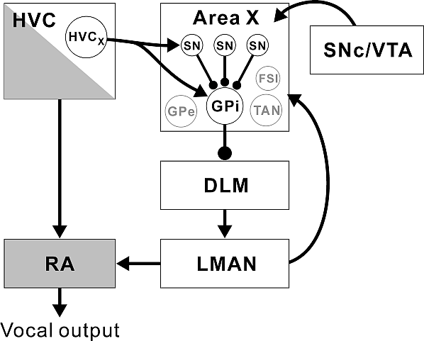
Variability in behavior
Directed songs have much less variability than undirected songs
LMAN activity generates behavioral variability important for learning
Doupe 2006-2012
Kao, Wright, Doupe 2008

Slide 27
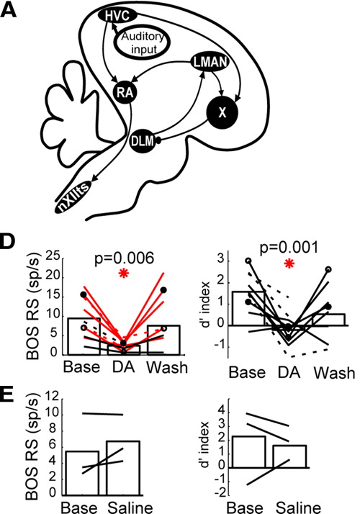
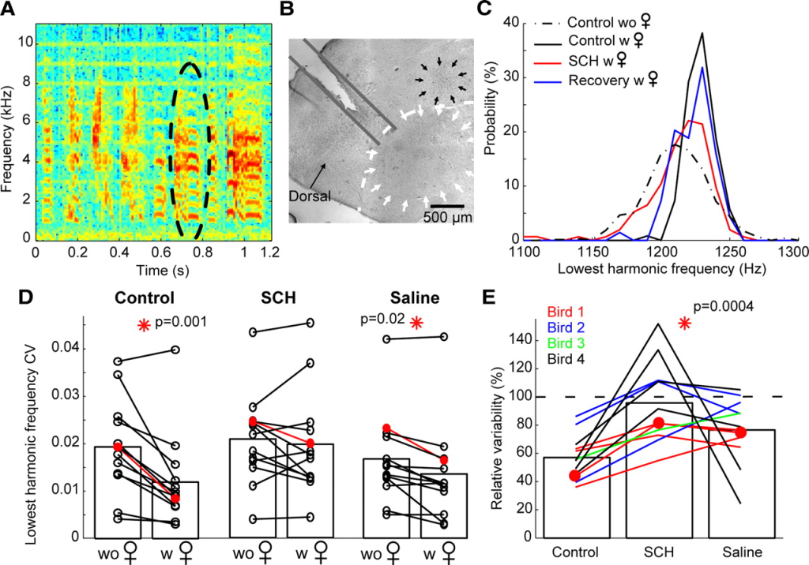
Variability in behavior
Song variability is decreased by dopamine
Leblois, Wendel, Perkel 2010

Slide 28
Why small networks?
Knowing the circuitry helps
  Identify the processing mechanisms
  Understand what the whole network is doing
  Understand the true inputs and outputs of the network
Identify inter-network interactions that give rise to variability
Identify the role of neuromodulators in changing the dynamics of the network and its level of variability
Manipulate whole networks rather than individual neurons.

Slide 29
Some thoughts…
Do neurons or networks use noise to their benefit?
  To prove this, one must show that changing the levels of “noise” intrinsic to the system affects its performance.
Do neurons act as input-output devices?
Do networks act as input-output devices?
Are networks (not individual neurons) really noisy?
Is maximum “information transfer” desirable for a neuron or network?
  Not necessarily (McDonnell & Ward, 2011).

Slide 30
(Tentative) Conclusions
If the nervous system is considered as a “closed system”, what seems like noise may be just our observation of the internal state of the system (as in the “modem” analogy).
Even with a “feed-forward” view of the CNS, to understand how noise influences neuronal or network output, we must understand what these neuronal or network signals communicate to their downstream targets.
To understand the effect of noise we must account for the “state” of the network.

